Slide 1
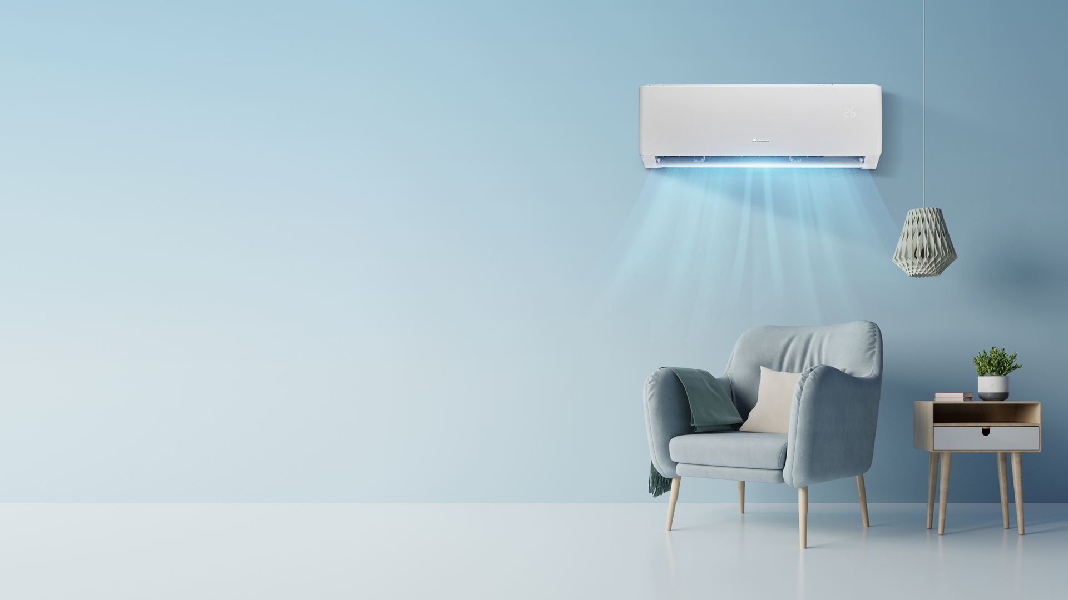
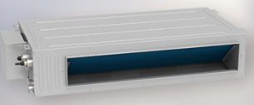

Wi-Fi connection U Match ducted, underceiling/floor and cassette systems

Slide 2
The following is a guide to connection of the U Match units to the Gree+ App. The App does have instructions as you go that should be helpful as well.
Ensure your router can connect to 2.4ghz as heat pumps of all brands run on this.
Download the latest version of Gree+ from Playstore or App Store.
Sign up and allow prompts you are asked about and allow updates if required. The App now has a New Zealand location instead of Australasia.
There are 3 devices trying to connect together. A list of potential things to look at if the adding does not connect will come up. If you see the module through the device, it could be the router side not doing the final connection. You may need to talk to your service provider to ensure it can allow the unit to connect.

Slide 3
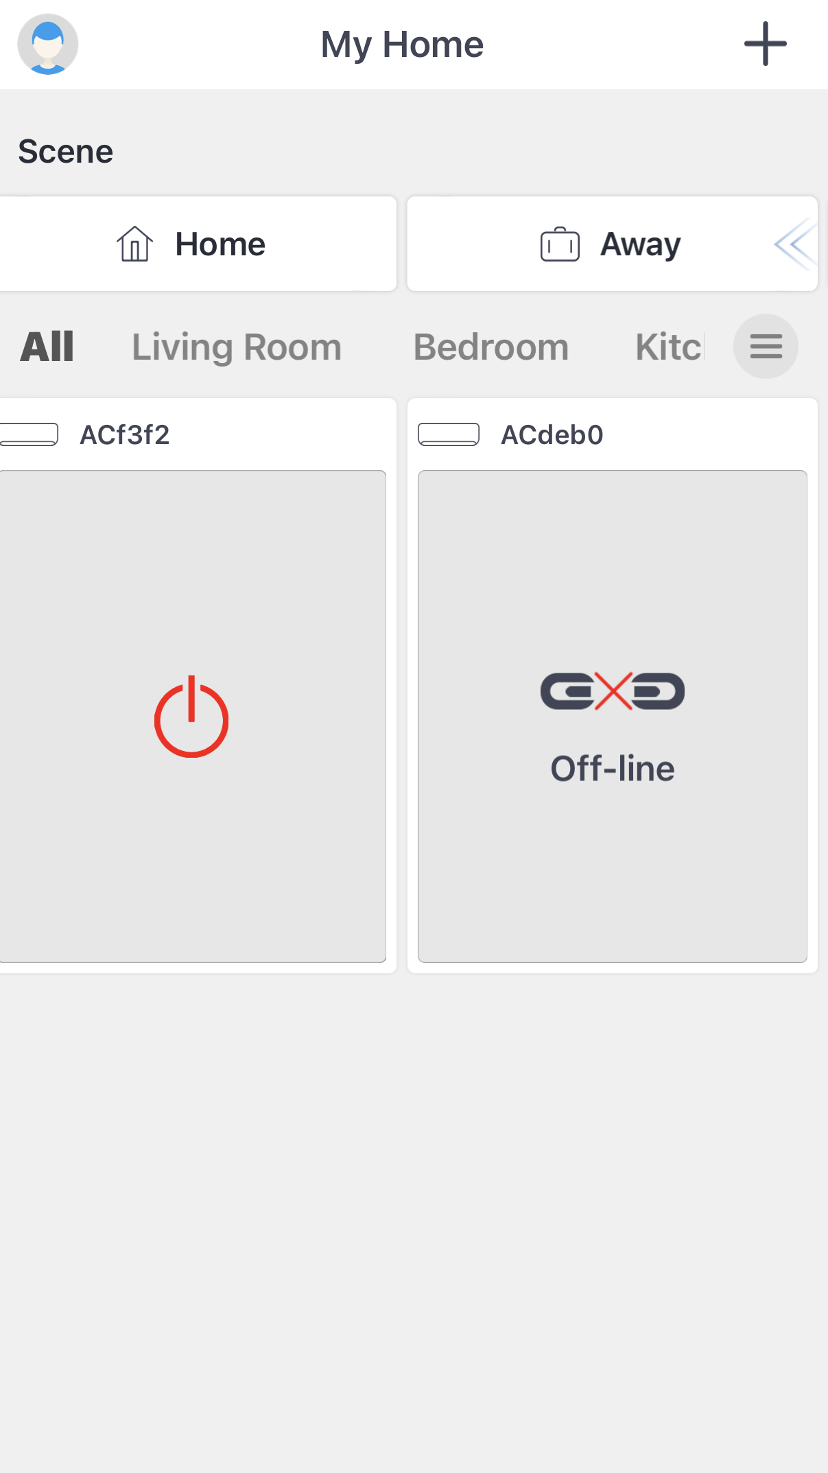
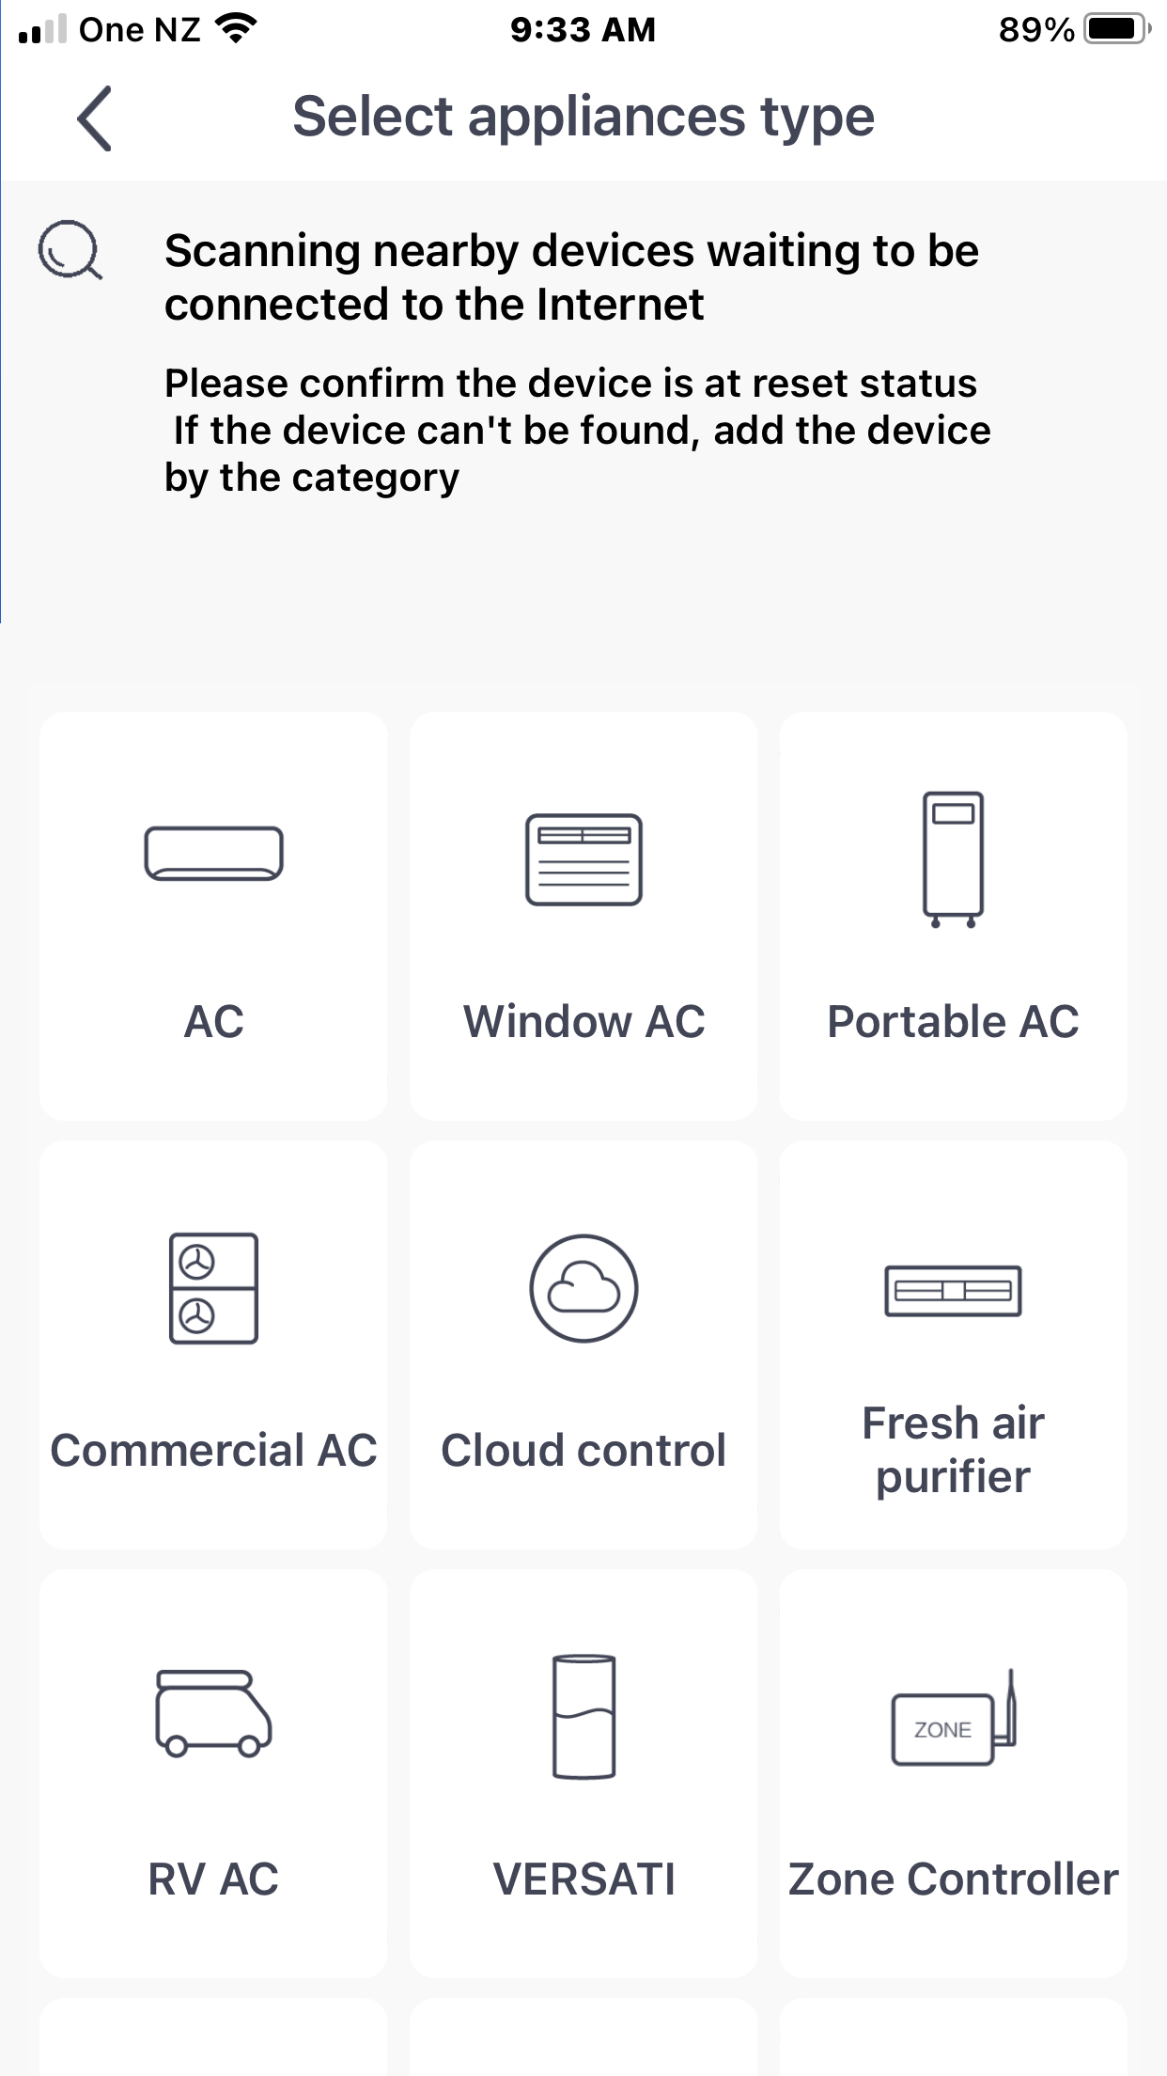
Click to add unit
Click Cloud control

Slide 4
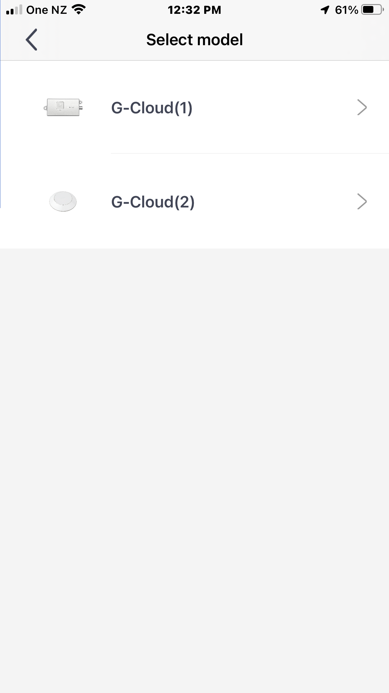
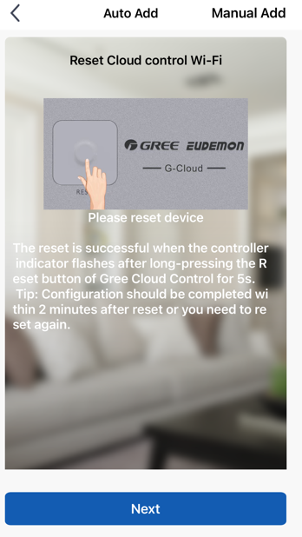
Choose G-Cloud(1). This will do the ducted, cassette and floor/underceiling units
2 ways to reset module. First is by G Cloud shown on the screen of your device

Slide 5
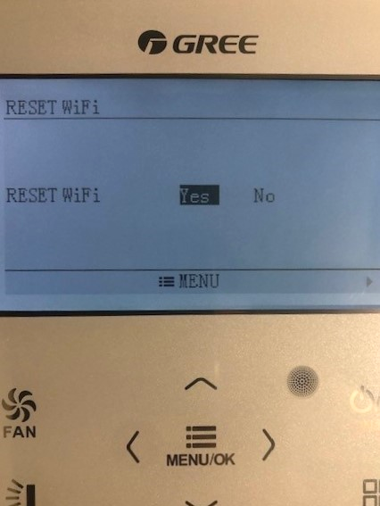
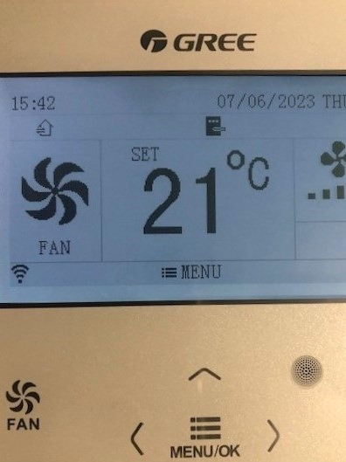
Or, second is by wall control. With unit on, press menu, then function and down to reset and yes
Wi-Fi symbol comes up on screen

Slide 6
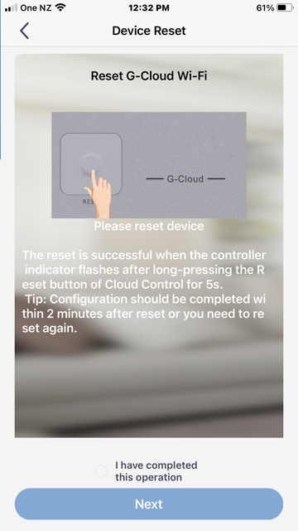
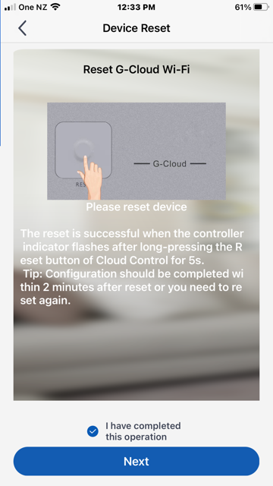
Use either reset option and then highlight ‘I have completed this operation’ before pressing Next

Slide 7
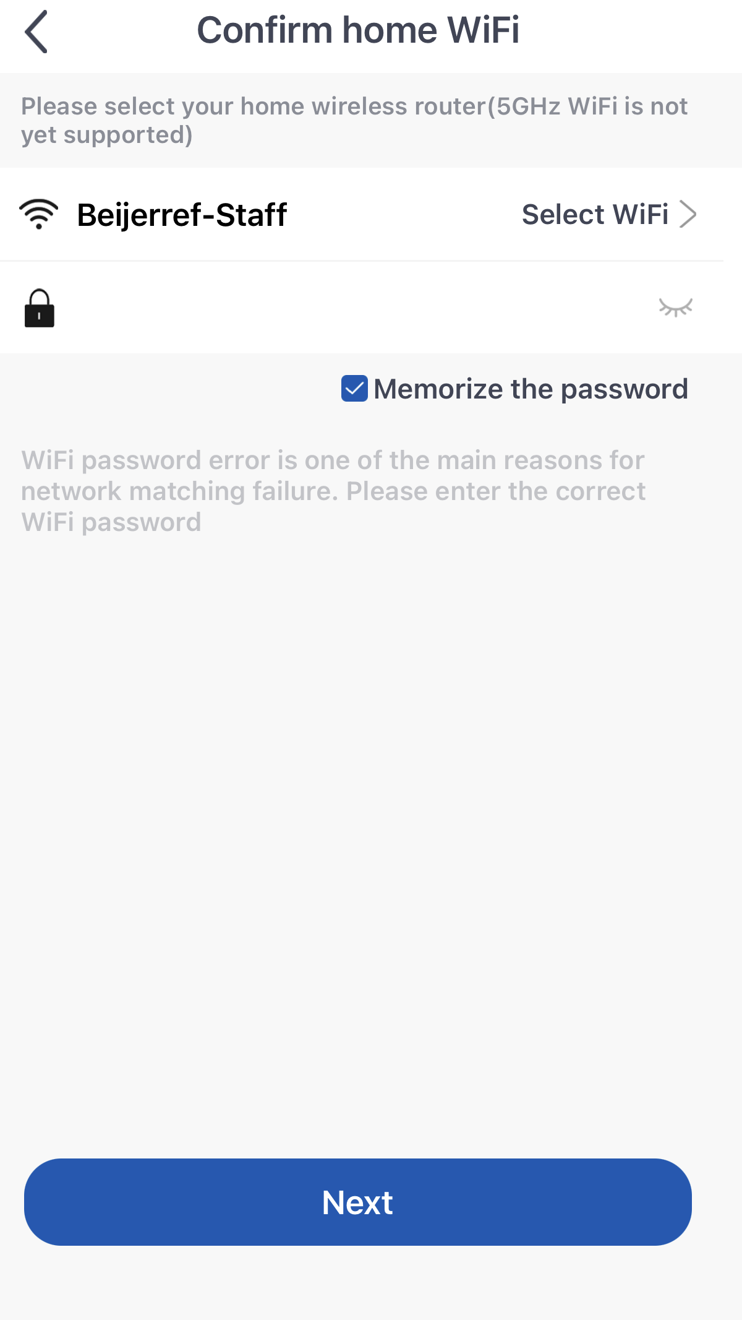
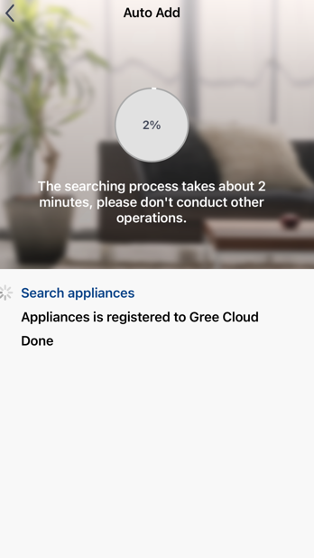
Select your 2.4ghz Wi-Fi and put in your home password
App will do a search

Slide 8
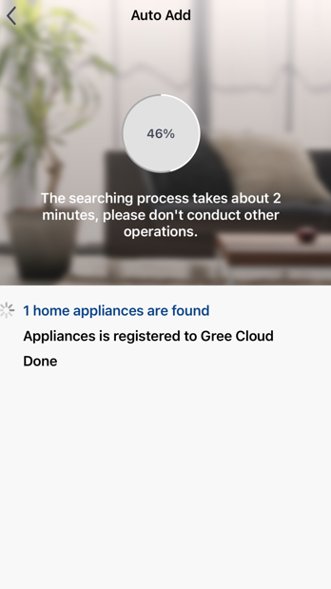
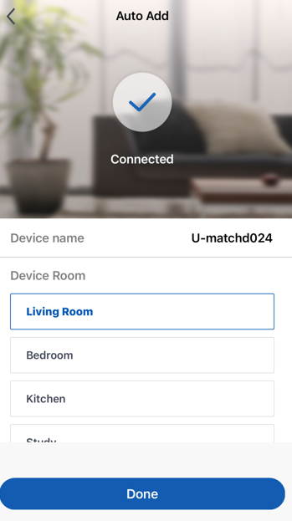
Should find your unit
Connects unit to the app

Slide 9
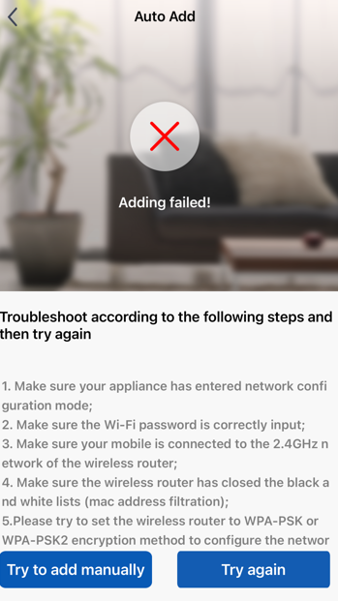
If it does not find the unit and shows adding failed, check the list of possible causes. The first ones are to confirm the app and Wi-Fi side. From 4 down you may need to contact the router provider to make adjustments to allow the unit in. If the module can be seen by the device these are ok and final connection to router is the problem. You can also try to connect manually

Slide 10
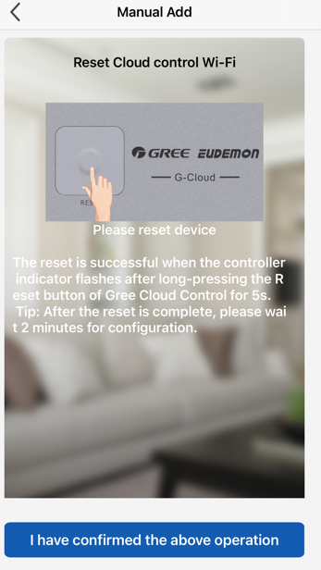
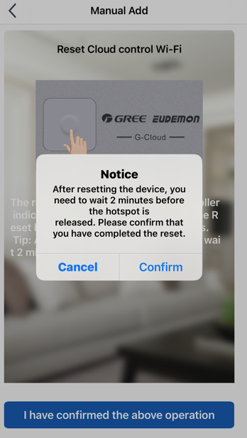
Reset Wi-Fi module or wall controller again and confirm

Slide 11
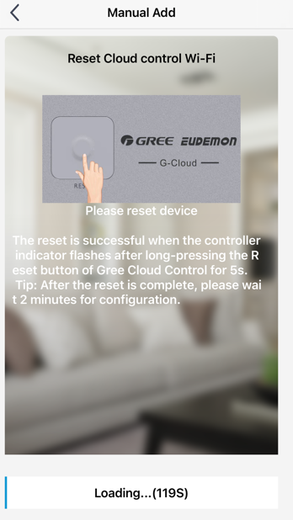
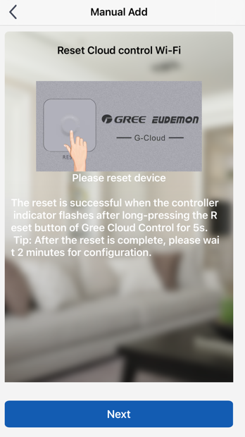
App will do a search for 2 minutes before you press next

Slide 12
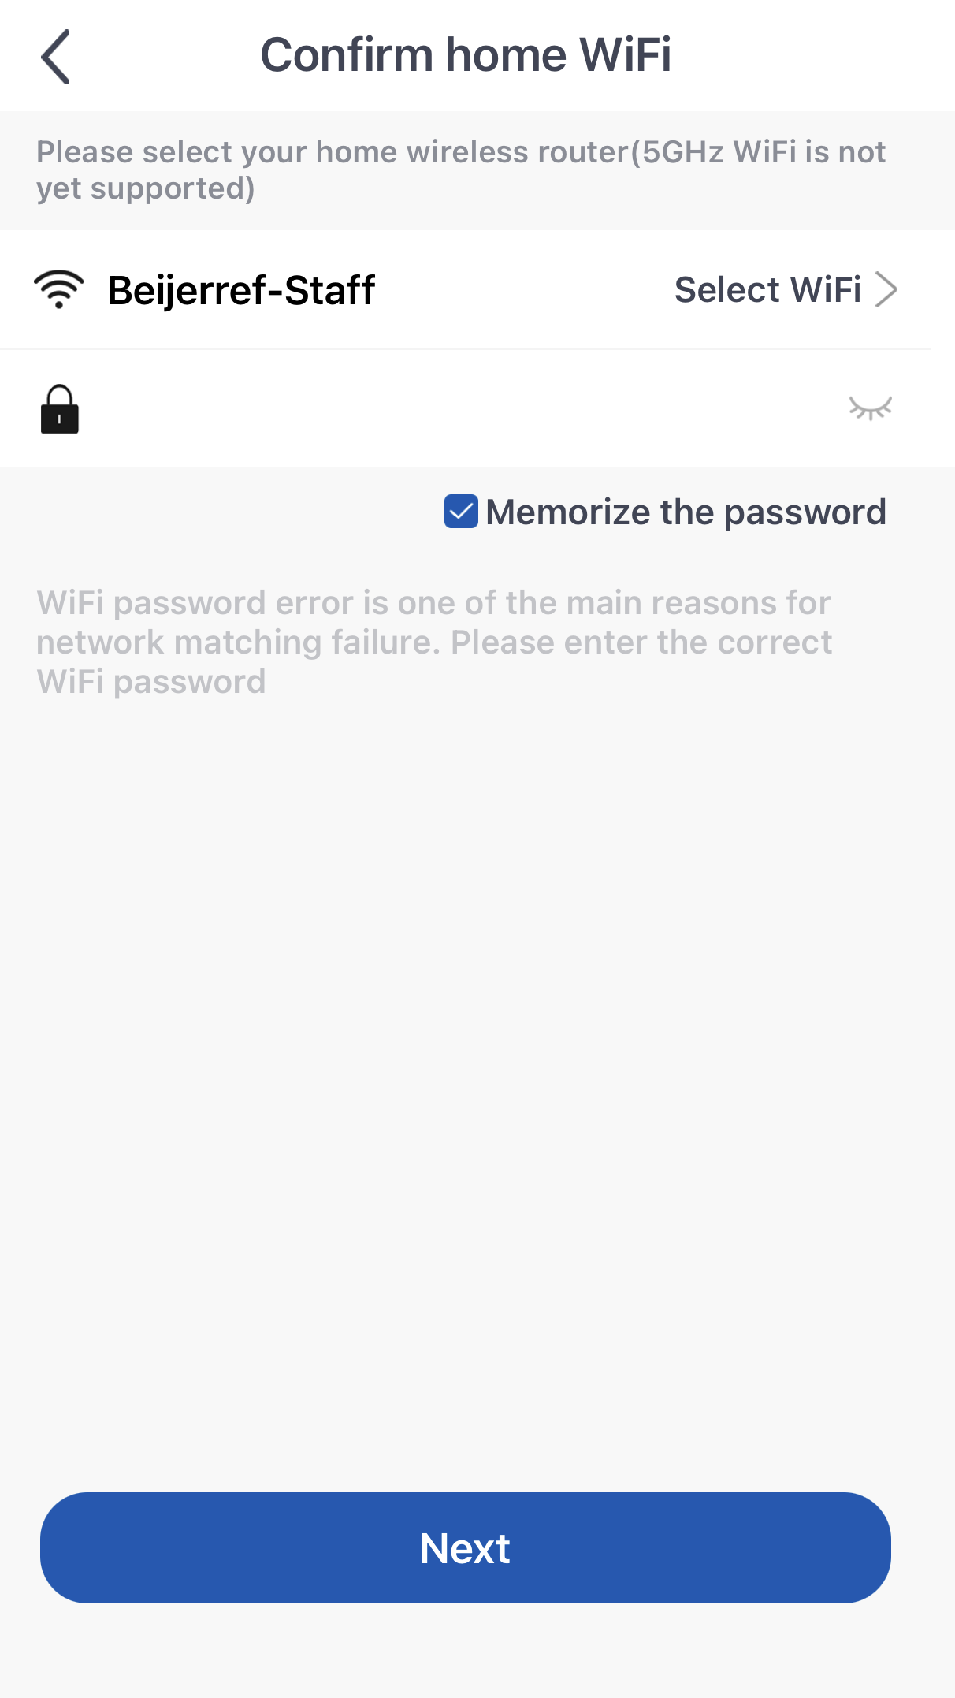
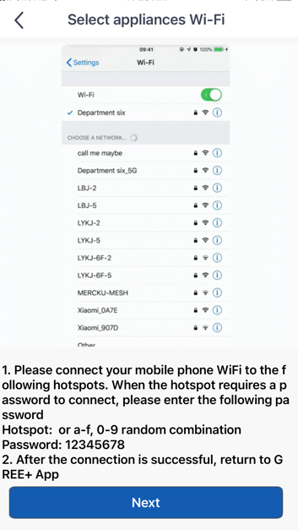
Make sure you are in the home 2.4ghz Wi-Fi
You will have the next step shown and this will give you the module password

Slide 13
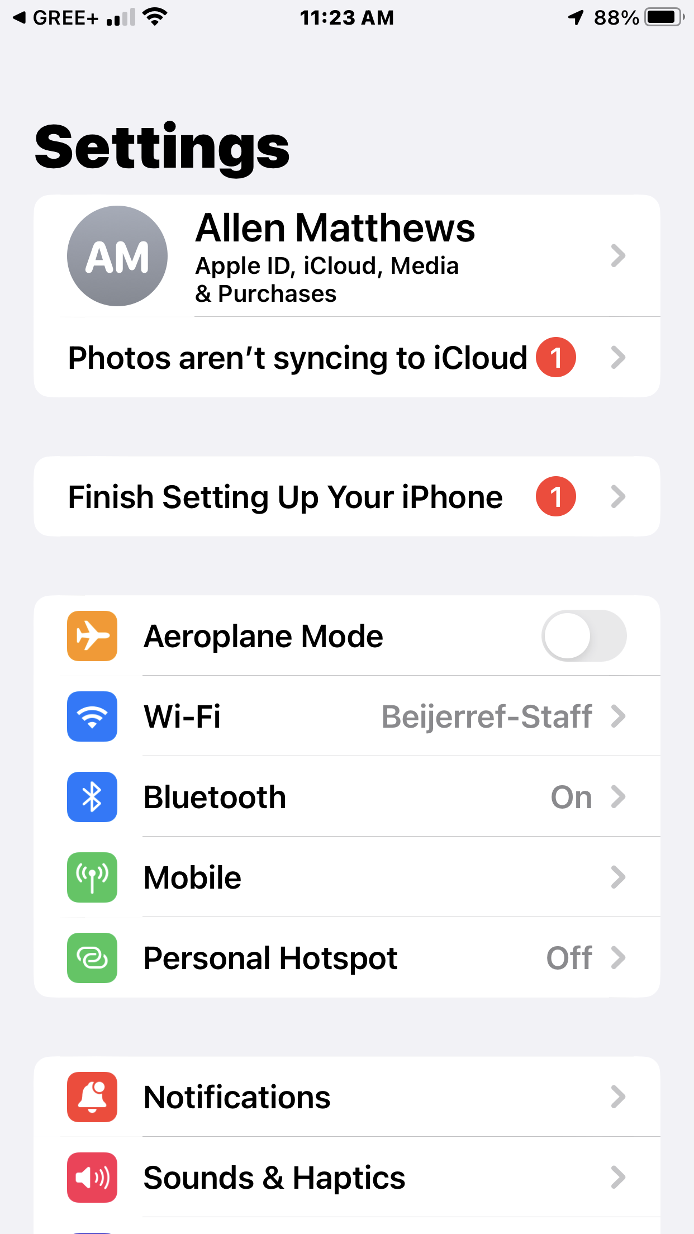
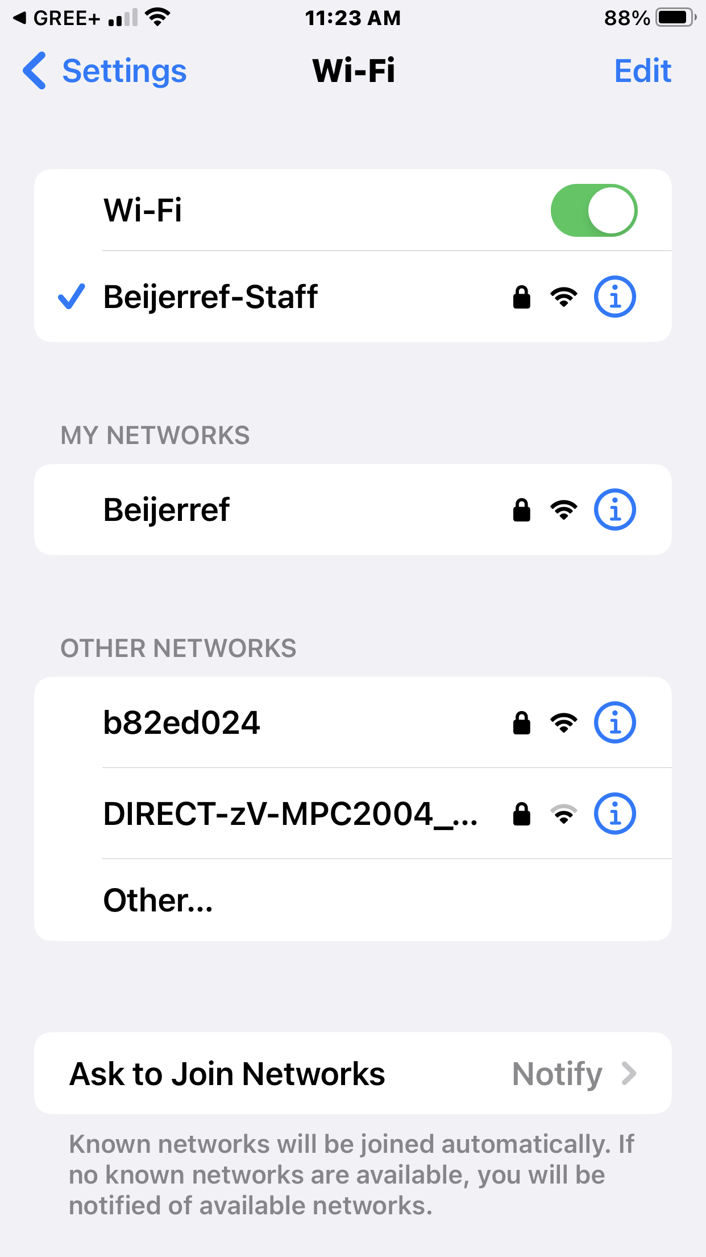
Click on Wi-Fi to go to the next screen
You should get a module come up in other networks which could be a mix of letters and numbers. Click on this and it will move to ‘Wi-Fi’.

Slide 14
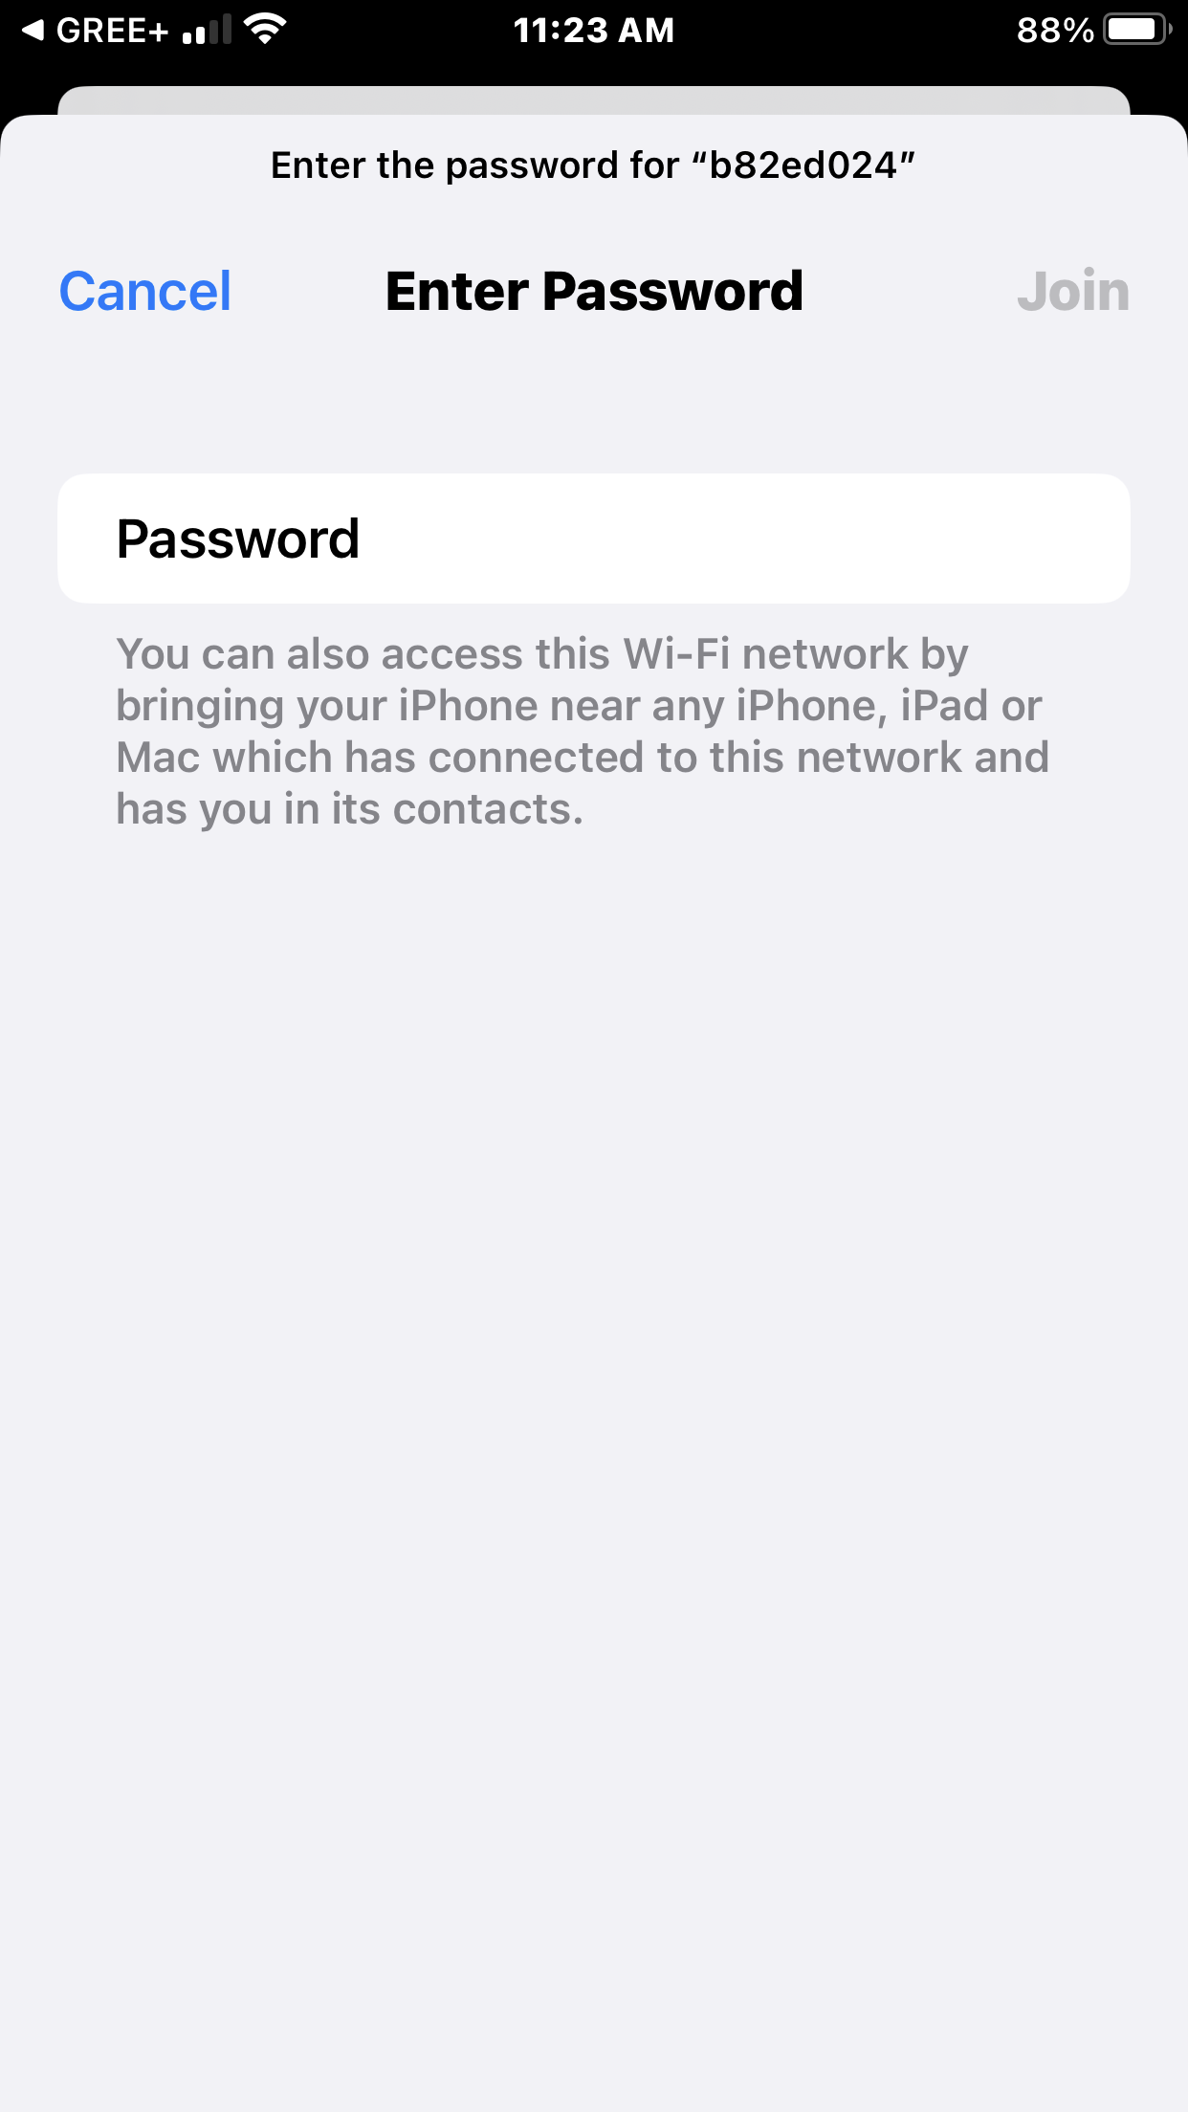
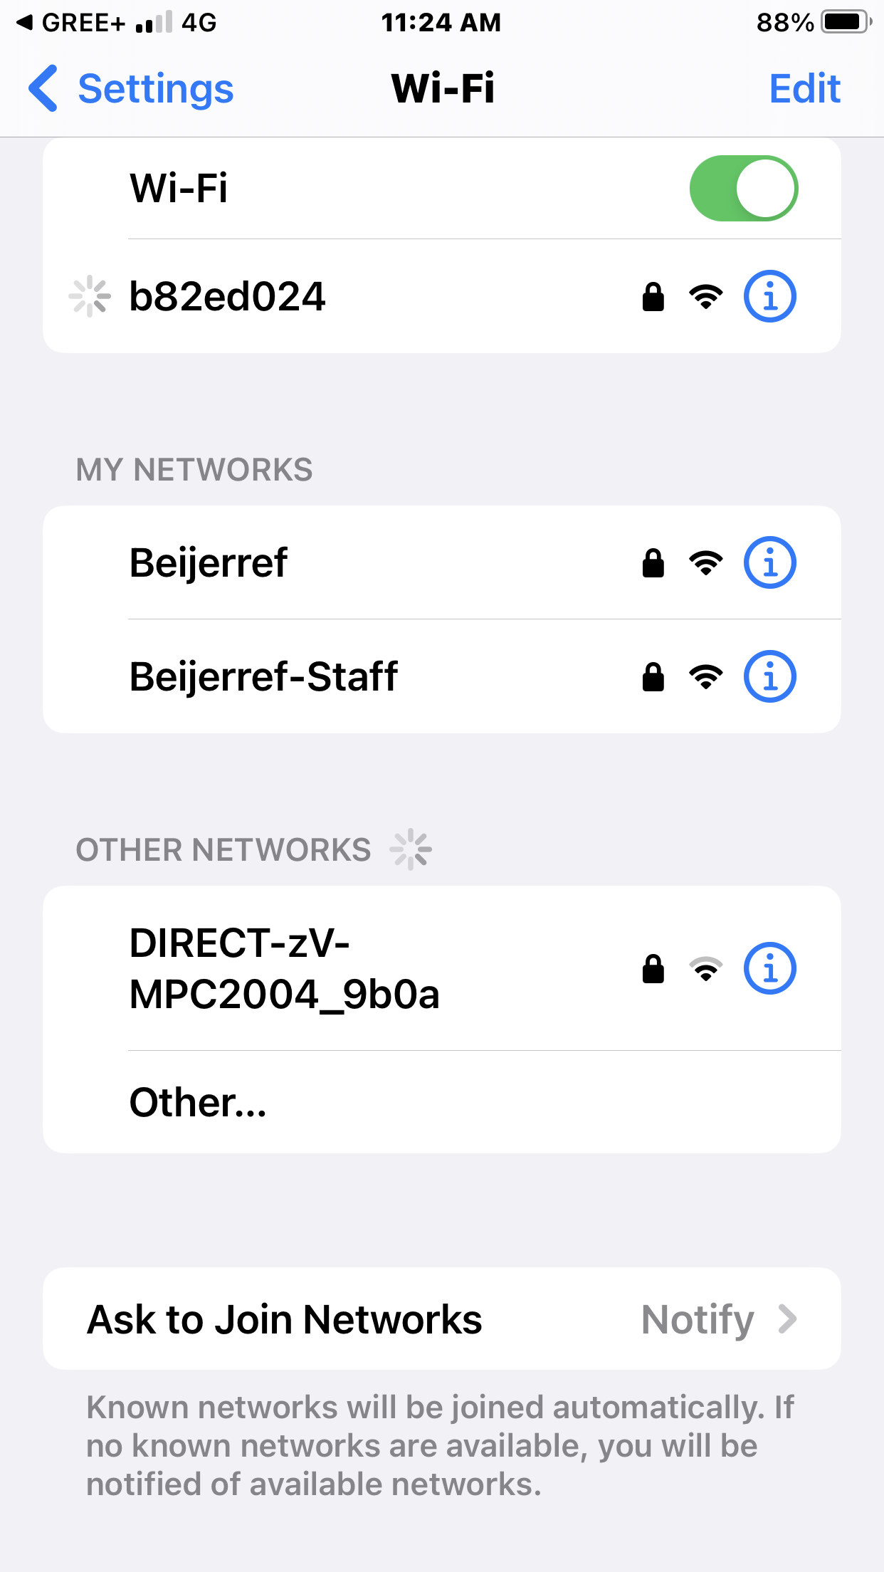
Put password, 12345678 in and press join
This module number will move up to Wi-Fi

Slide 15
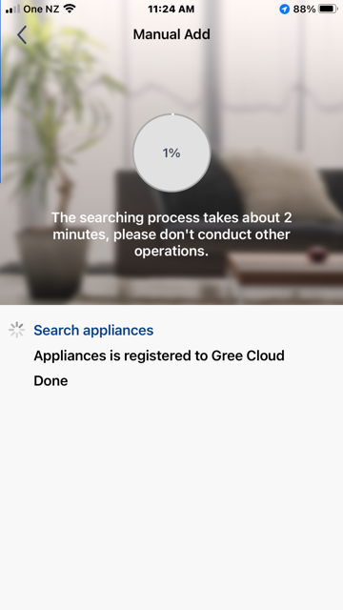
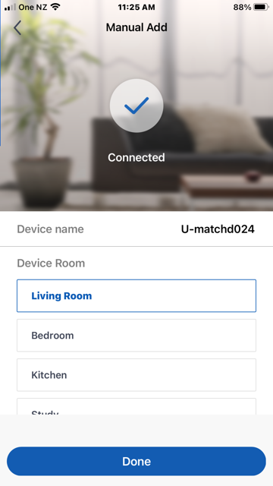
Another search will be done and should find the unit

Slide 16
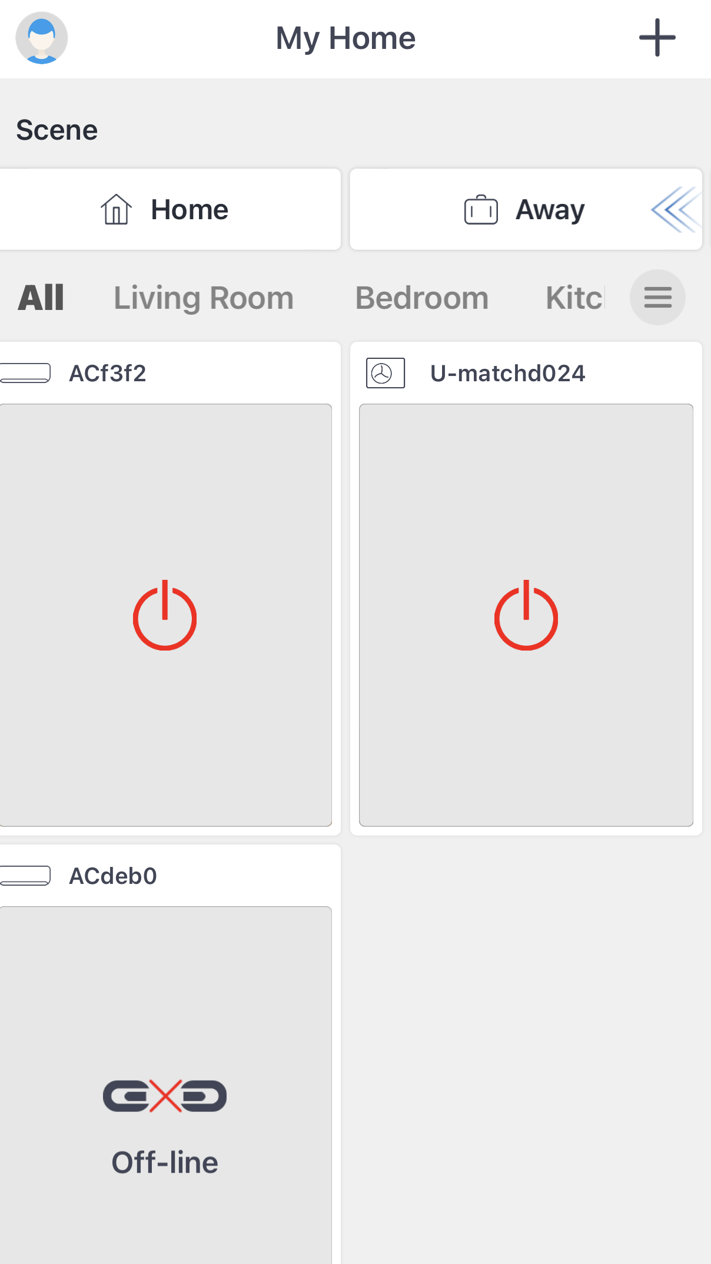
Click on head symbol to complete connection steps
Unit will now come up now on the home screen of the app

Slide 17
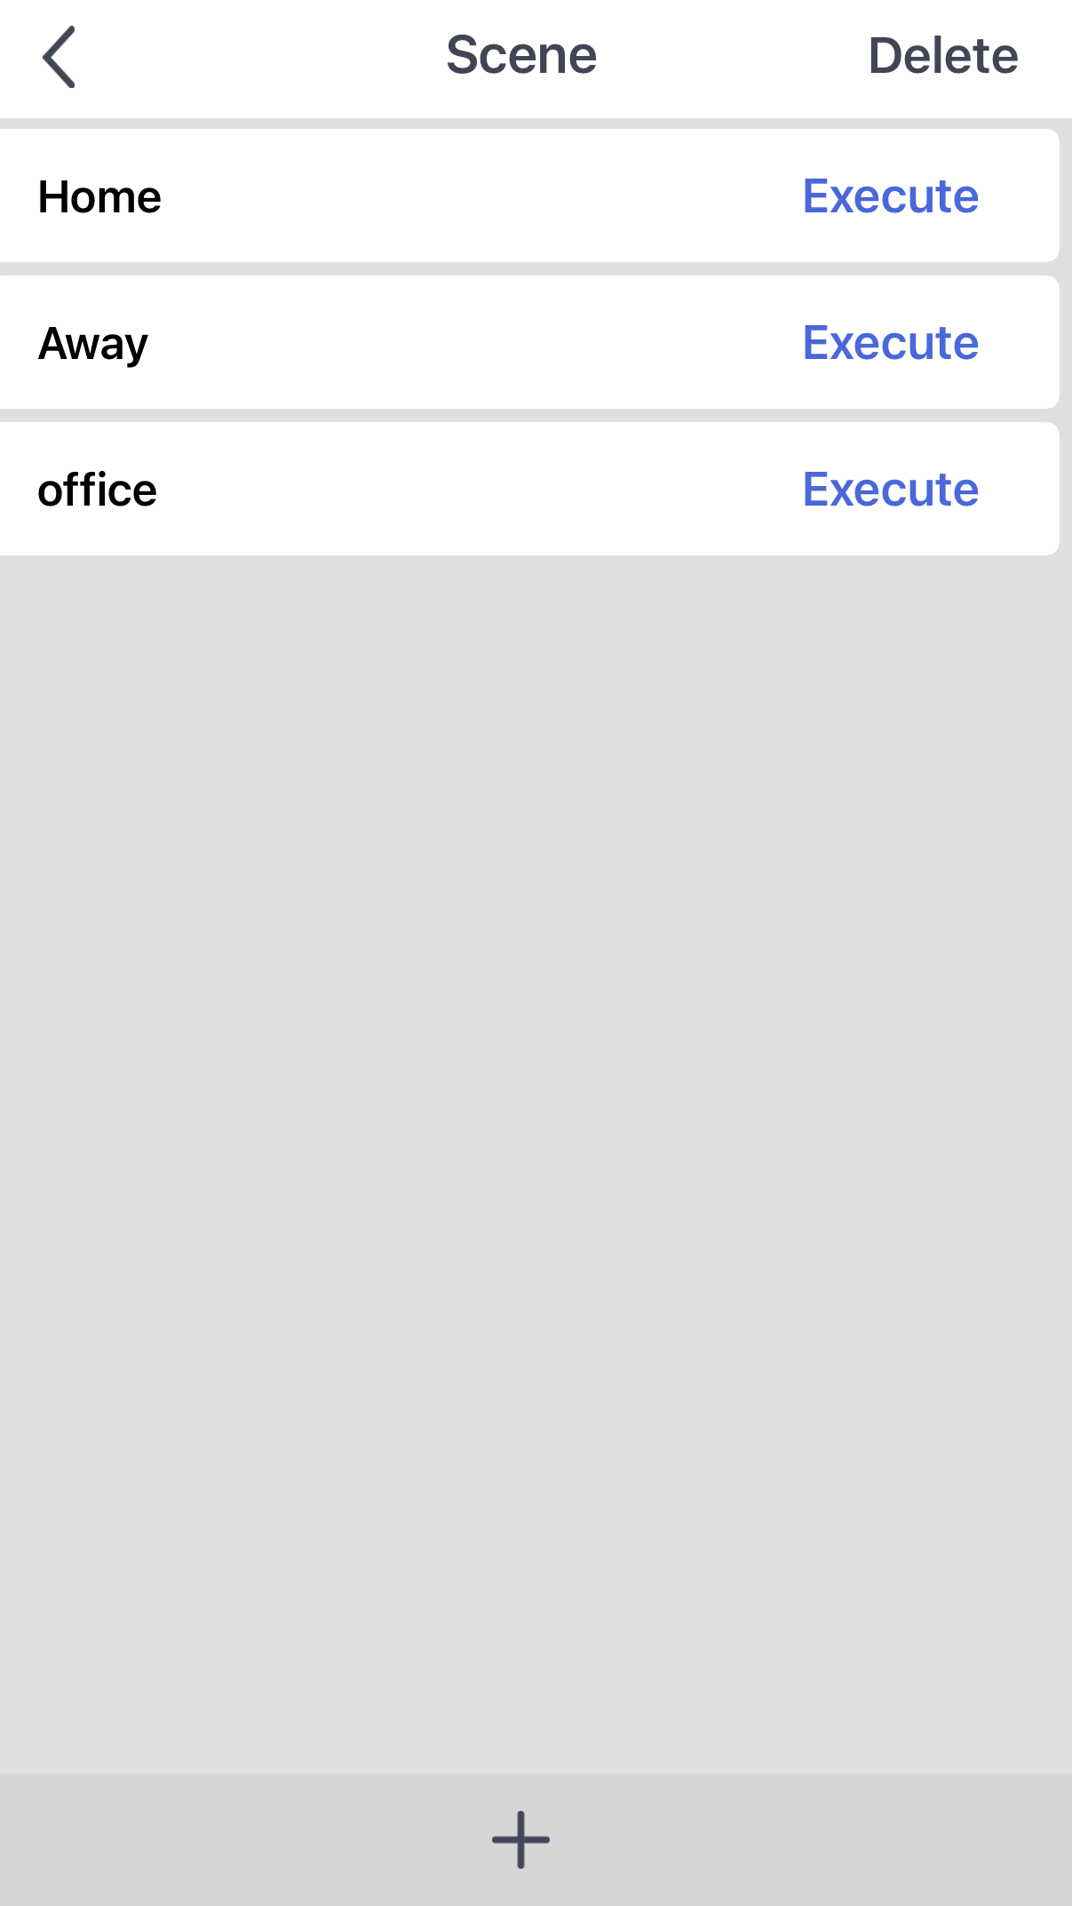
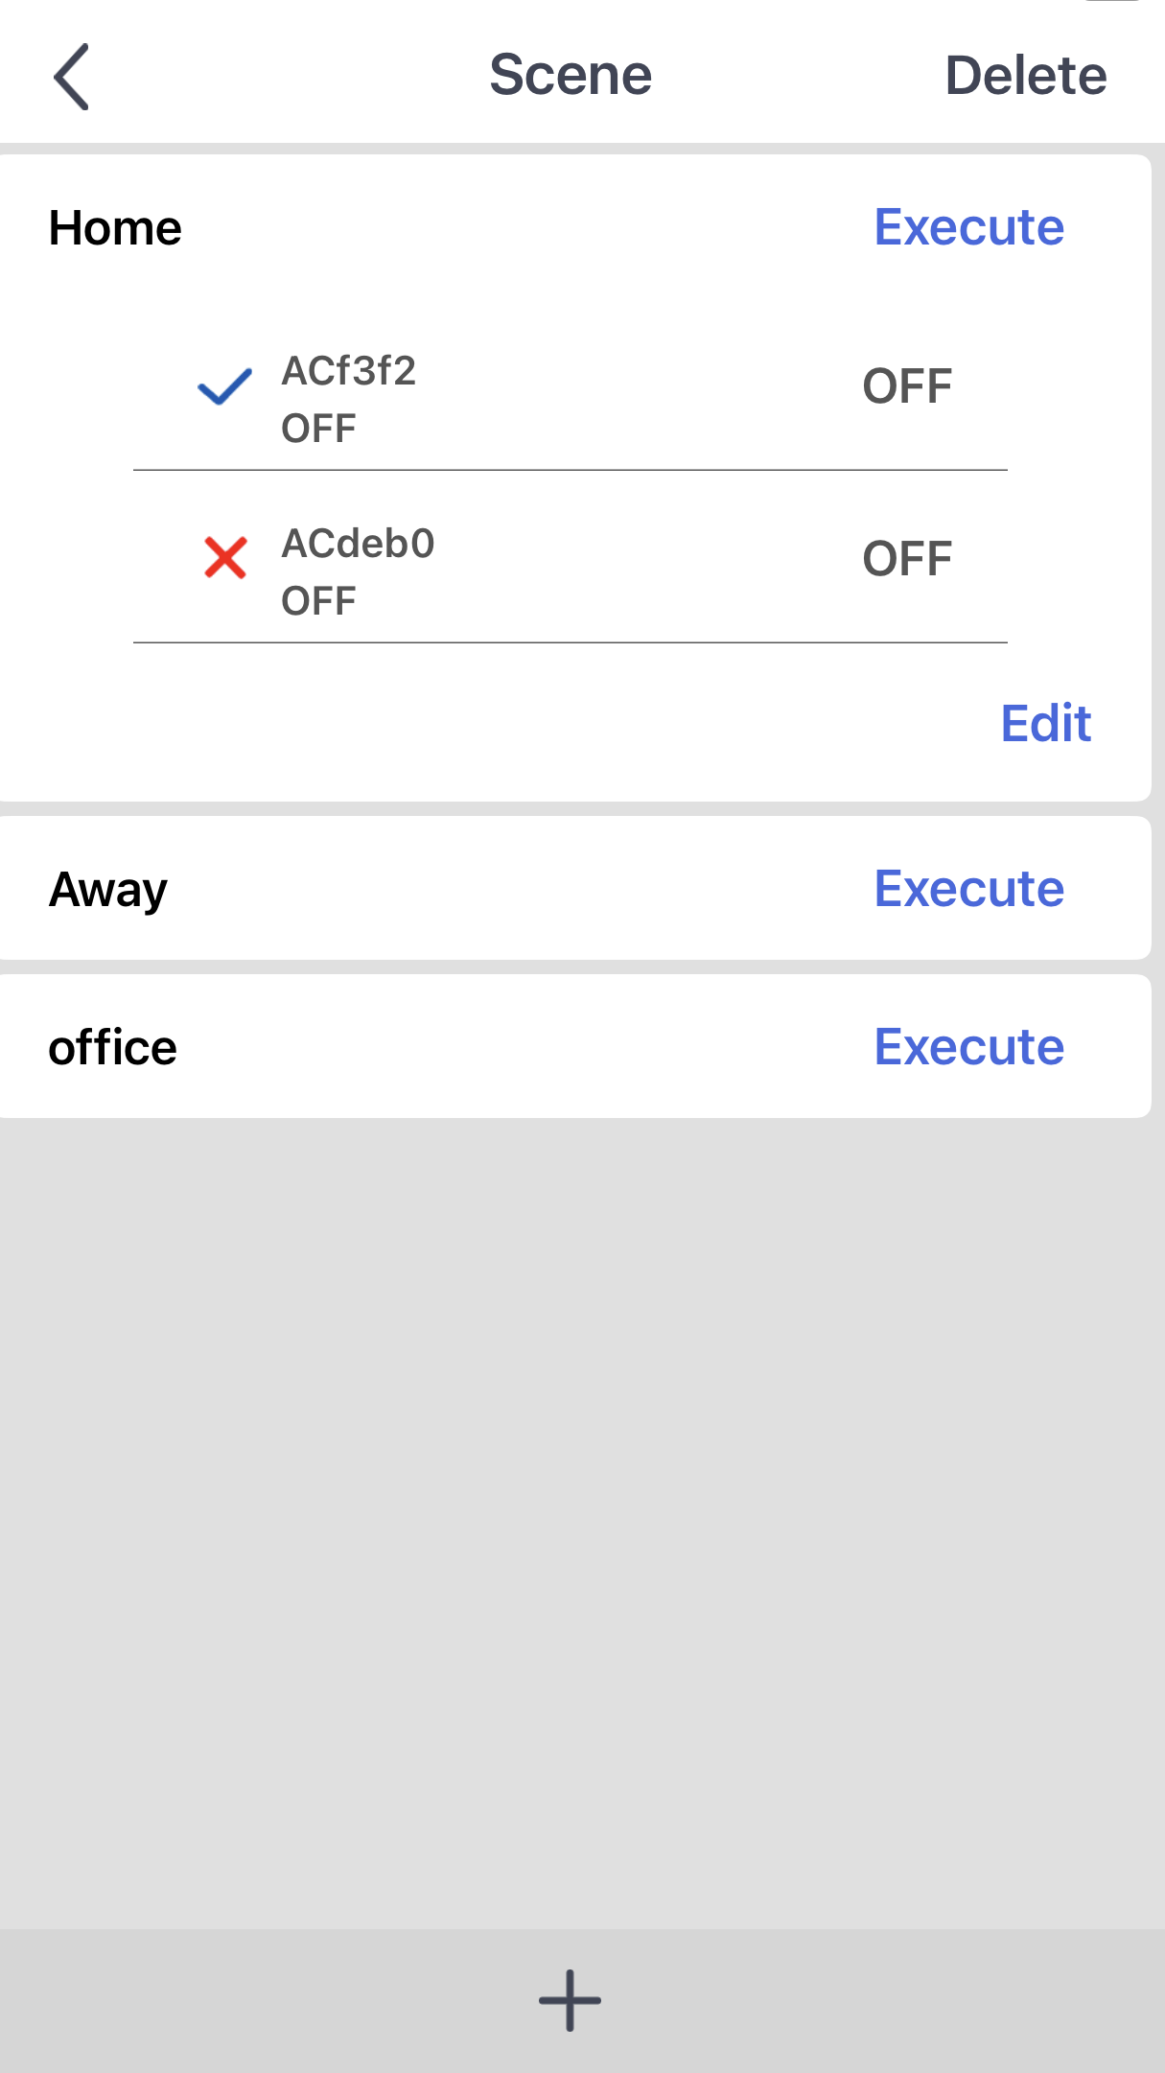
To control the unit from home or while out we need to complete the final stages
Click on Home Execute and then Edit

Slide 18
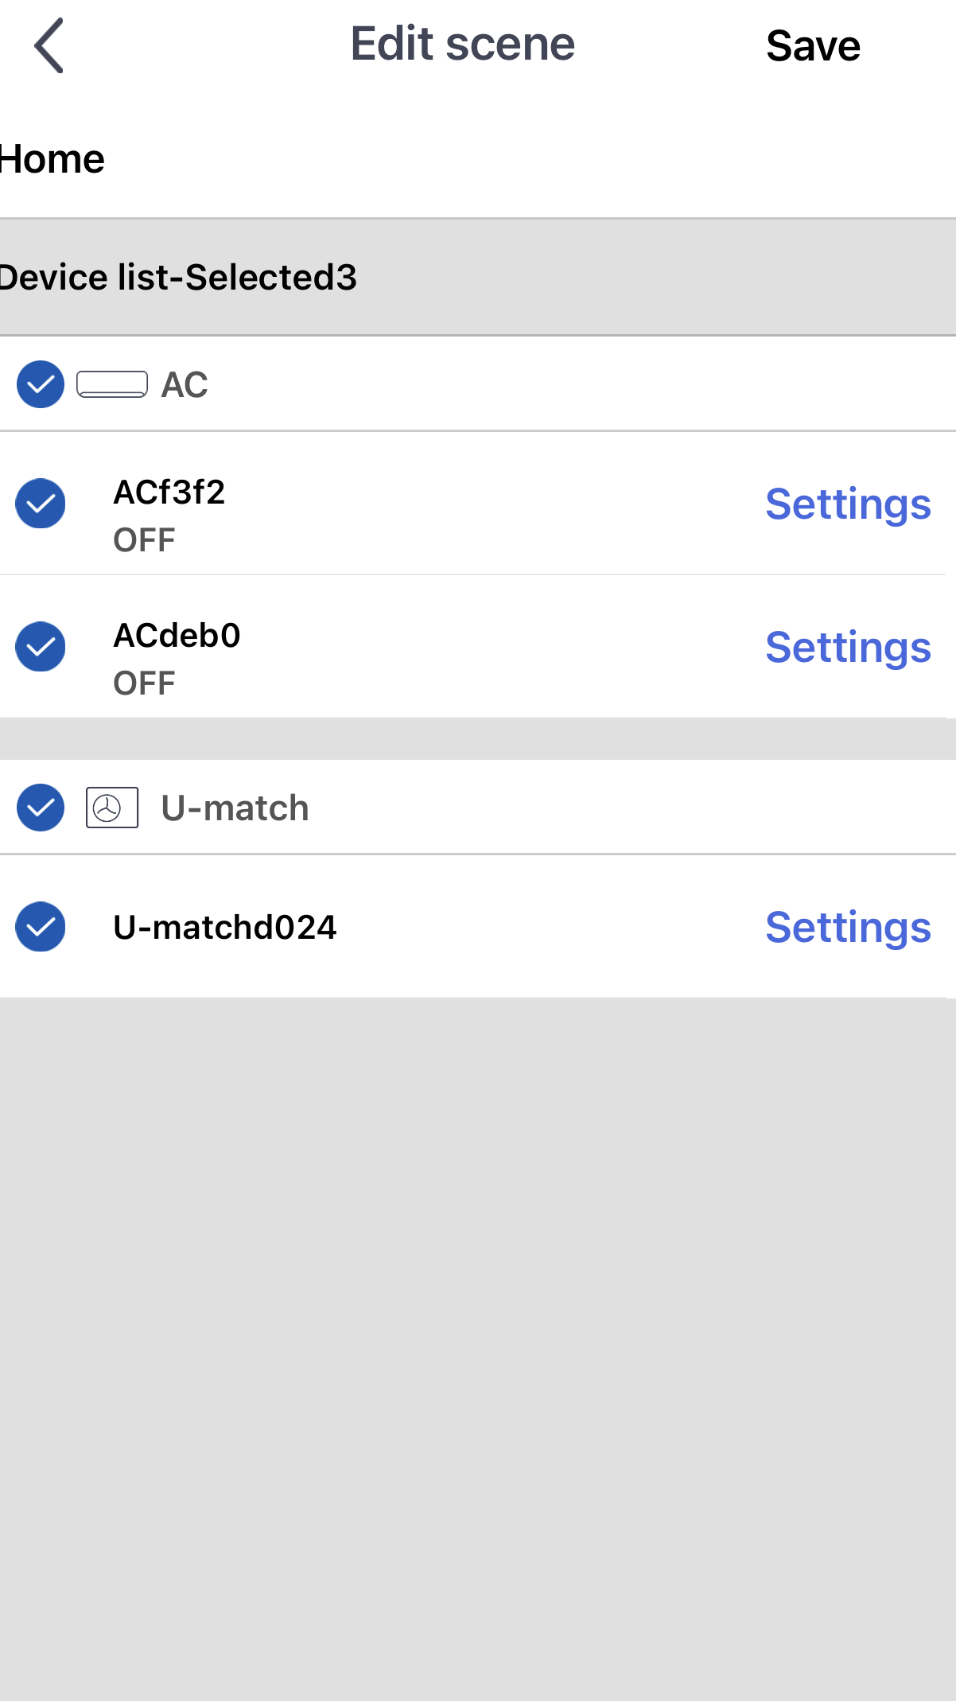
Highlight AC and the unit you want to control and then Save.

Slide 19
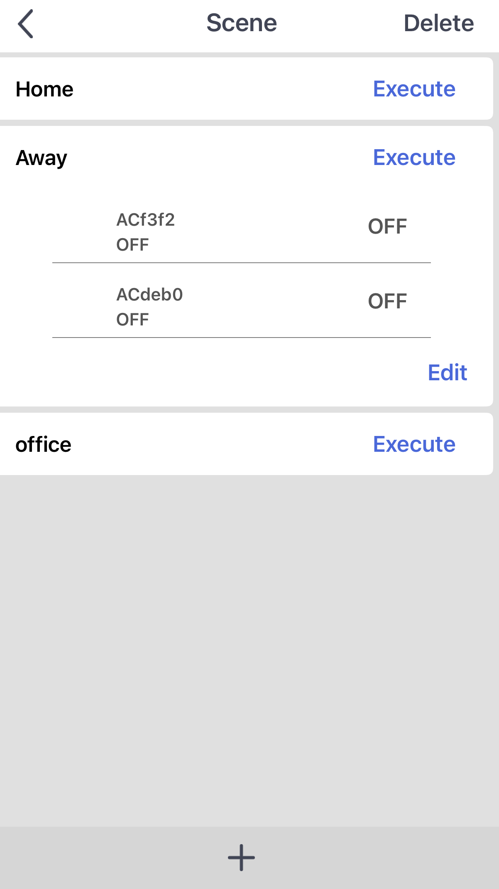
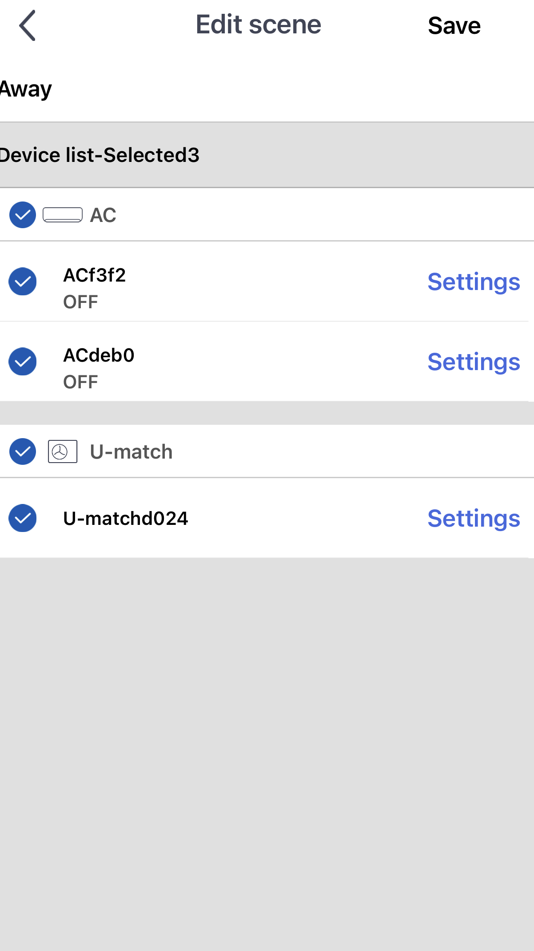
Do the same to add the unit for control while away from the house and save

Slide 20
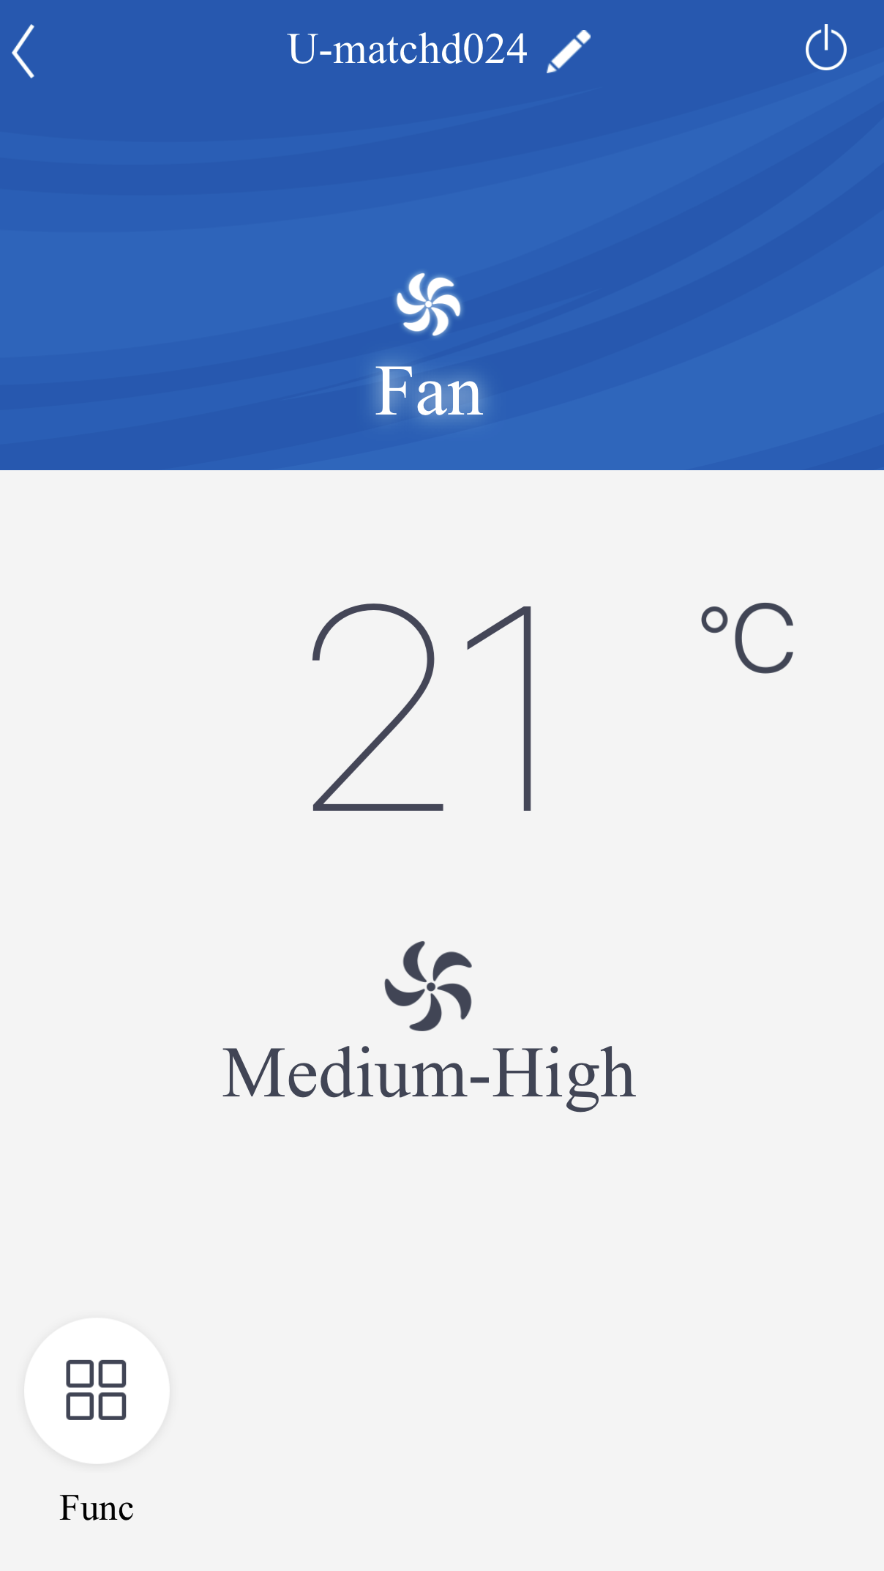
You can now press on the unit and full screen will come up to control it

Slide 21
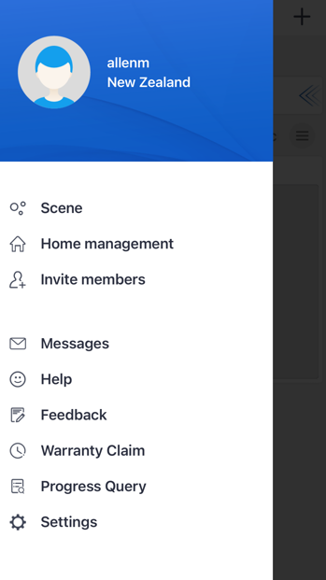
Also when clicking the head symbol there are several other menus you can go into

Slide 22
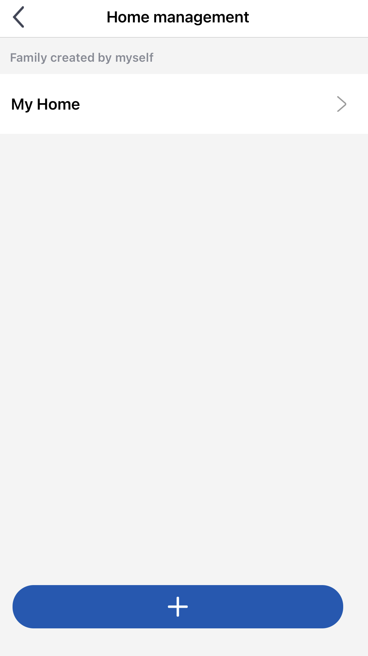
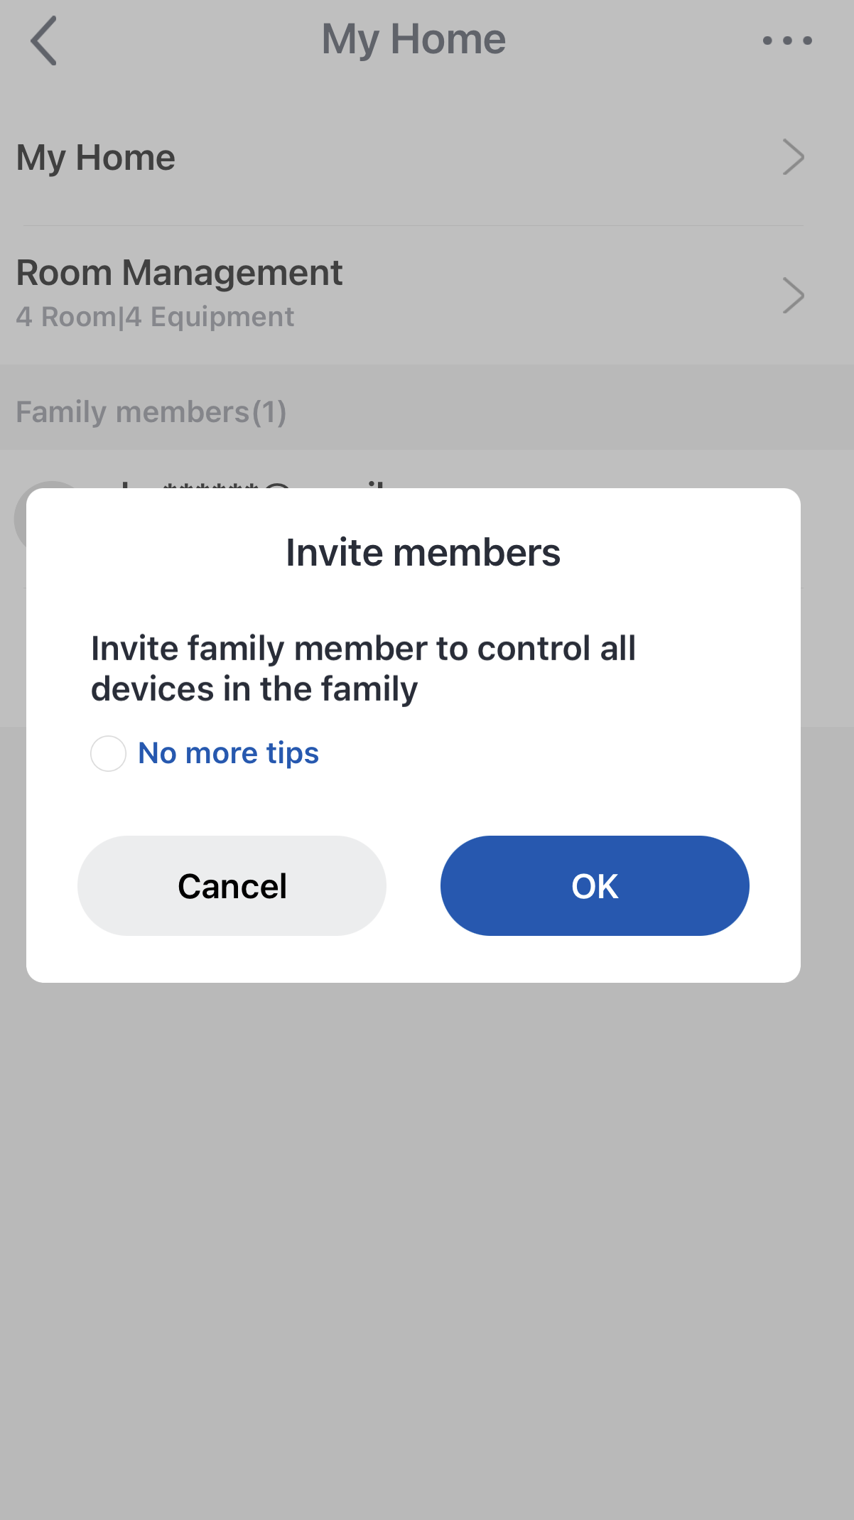
Home management shows units you have connected and has the ability to invite members into the group to control these units

Slide 23
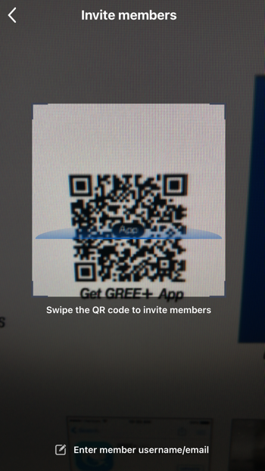
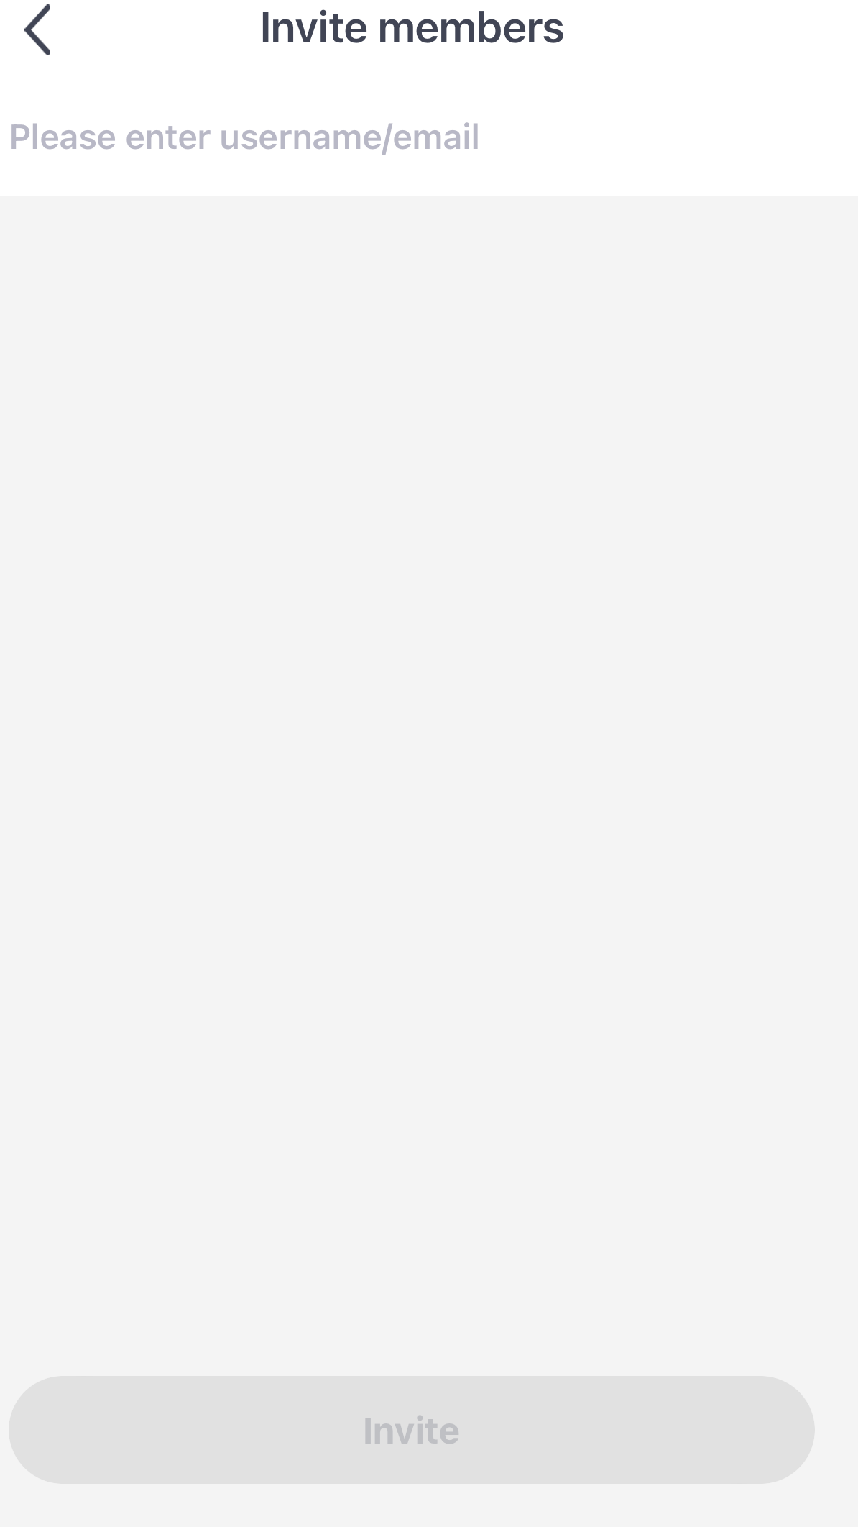
Invite members also gives you the option of inviting someone else to control the unit. This can be done with QR code or email

Slide 24
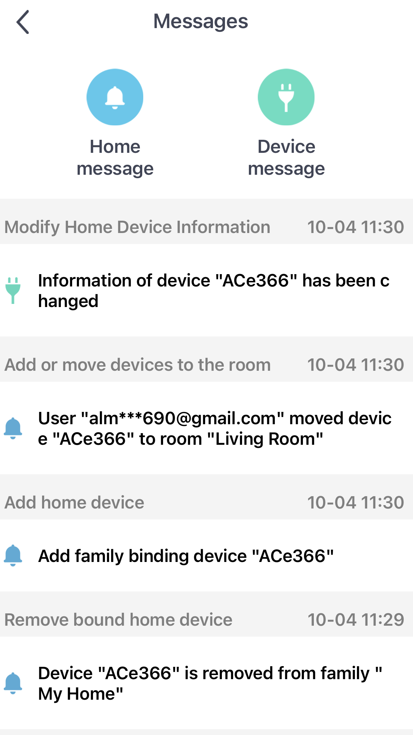
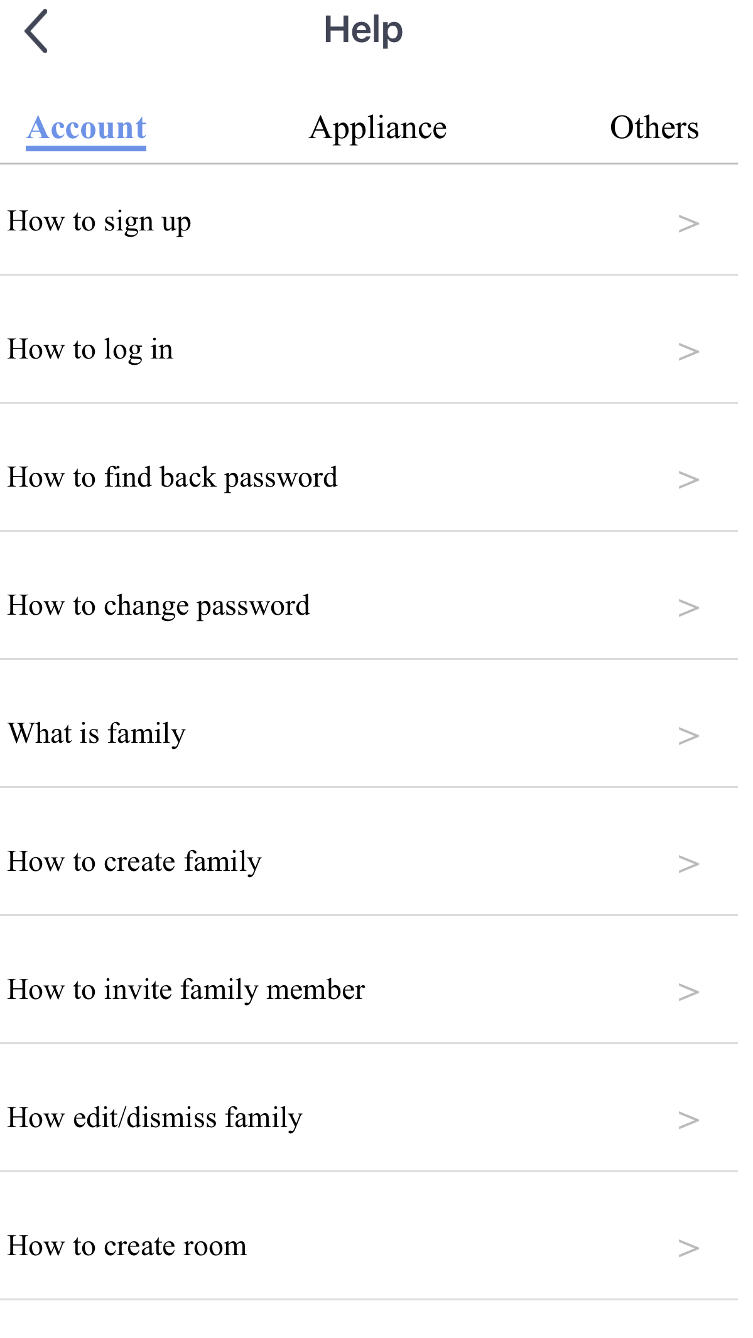
Messages shows you any changes you have made in the App
Help has a drop down list to help make connection and editing easier

Slide 25
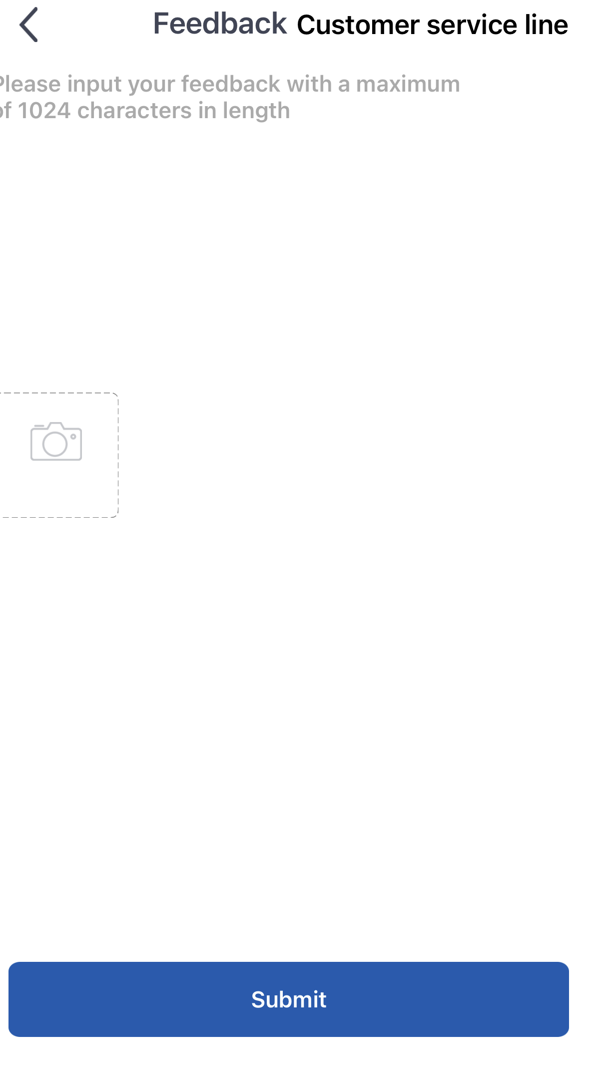
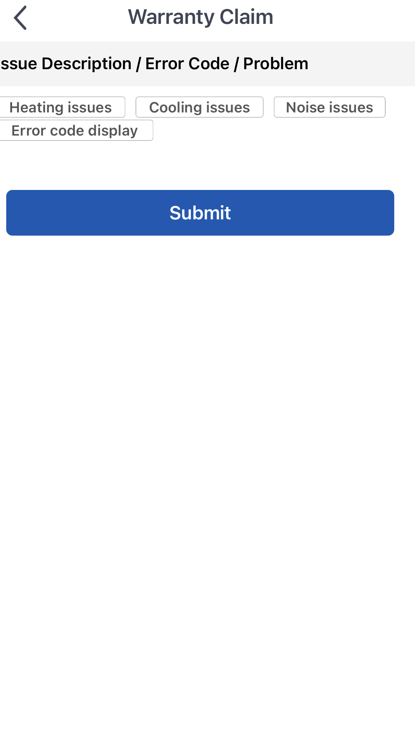
You can feedback information to the Gree factory regarding the App and they can respond
You can advise the Gree factory of problems with your heat pump, and they can respond to this. You would have included your email in registration

Slide 26
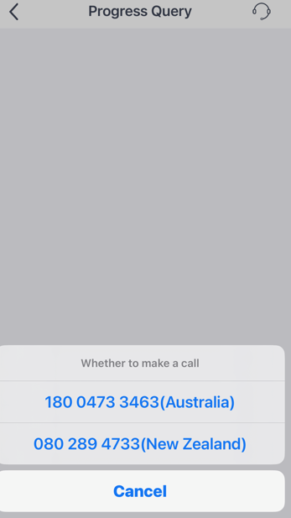
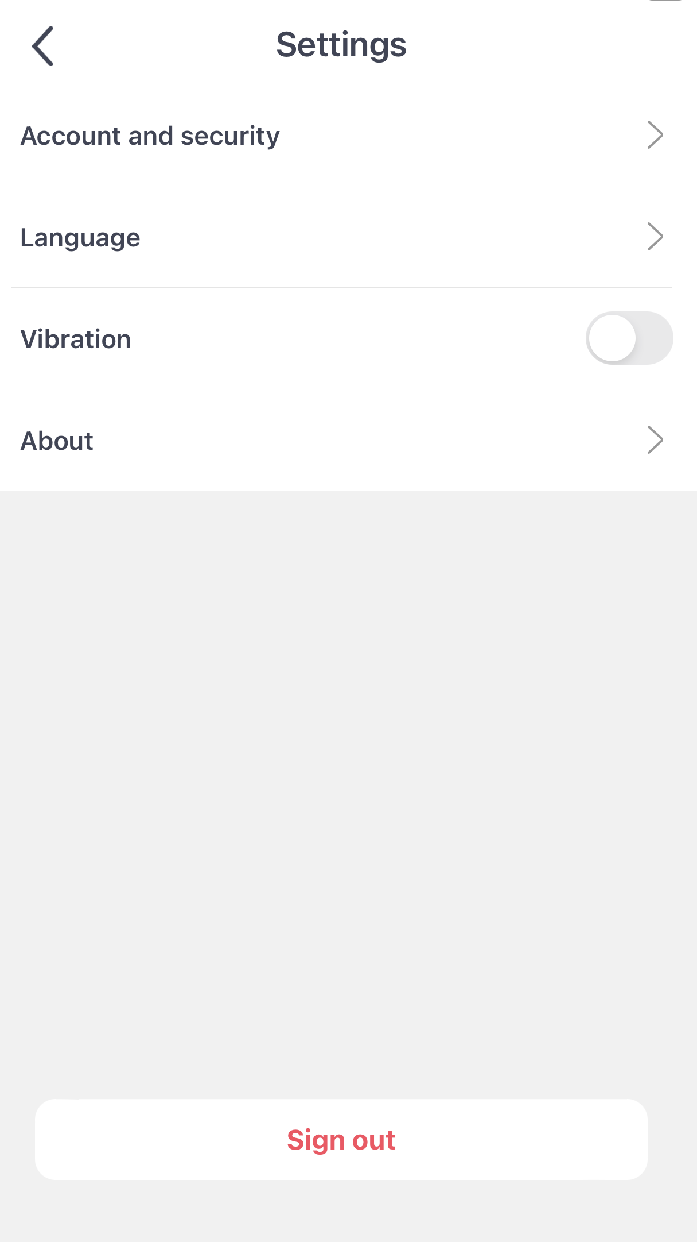
Progress Query gives you the Aust and NZ numbers to call to help with issues on the App
Settings gives you access to change your password, change language, cancel your account,rate the App, show you the version you have, give you the privacy policy

Slide 27
Contact Gree AU
1800 473 346 greeac.com.au

